Slide 1
Literary History
5V
November 2023, December 2023, January 2024
Test in Testweek 2

Slide 2
Literary Periods
Old English Period
500-1066
Middle English Period
1066-1500
Renaissance
1500-1660
The Regency
1811-1820
Romantic Period
1798-1870
Age of Reason
Enlightenment
1660-1800
Victorian Period
1830-1900

Slide 3
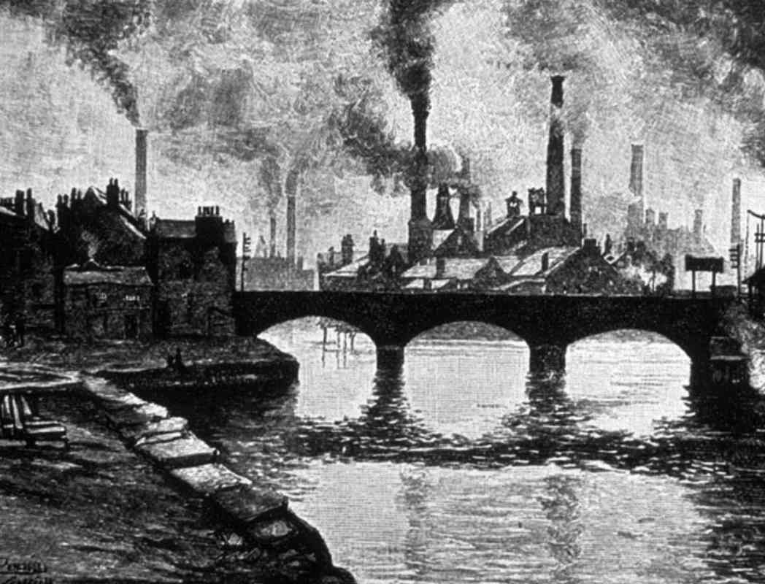
The Victorian Period
1830-1900

Slide 4
The Victorian Period 1830-1900
History
named after Queen Victoria
Victoria ruled from 1837-1901
scientific progress: major discoveries were made in all branches of science, including physics, astronomy, natural history and medicine
also a time of hardship and struggle
The Victorian age was a dark period for children -> forced to work under extremely dangerous conditions in the new mines and factories which developed rapidly
The Industrial Revolution created a huge gap between the haves and have-nots.

Slide 5
The Victorian Period 1830-1900
Literary characteristics
depictions of everyday people, hard lives, and moral lessons
realism
books written/read in installments by common people
reaction to rapid changes in society
Literary works
Charles Dickens: Great Expectations, Oliver Twist, Hard Times, Nicholas Nickleby, David Copperfield, The Pickwick Papers, Bleak House, Little Dorrit, A Christmas Carol, A Tale of Two Cities
Charlotte Brontë: Jane Eyre
George Eliot: Middlemarch, The Mill on the Floss, Silas Marner
Thomas Hardy: Tess of the D’Urbervilles, The Mayor of Casterbridge
Oscar Wilde: The Picture of Dorian Gray

Slide 6
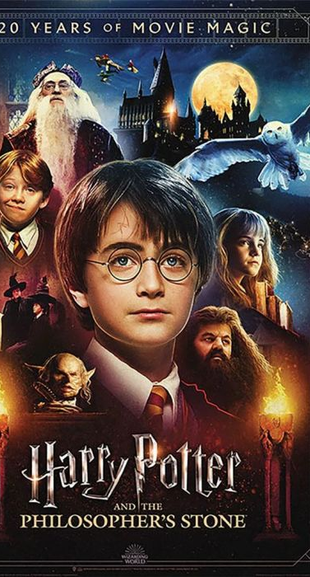
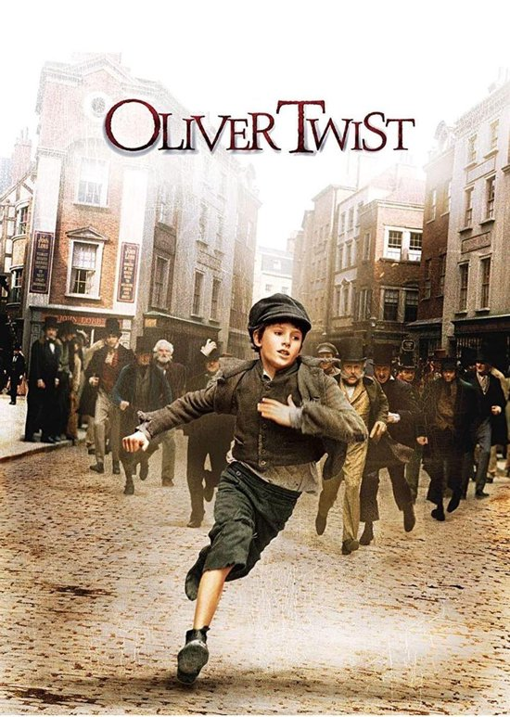
The coming-of-age novel
…also called a Bildungsroman, is about the protagonist’s journey from childhood innocence to experience and education: from being a child to being an adult, from being naïve to being wise, from being immature to being mature. There will usually be pain and suffering along the way, because growing up isn’t easy. There is a sensitive main character who searches for answers to life’s problems.
The story may begin with an emotional loss or difficulty.
The main character sets out to explore the world and leaves his/her childhood world.
The goal of this character is to be a mature, knowledgeable adult.
There is often conflict with the world.
The main character often helps others at the end of the novel because of all he/she has learnt.

Slide 7
Oliver Twist
Go to the reader to read the first 2 chapters of Charles Dickens’s Oliver Twist. Answer the questions on the chapters.

